Slide 1

Segmenting Complex, Real World Images with Dense Convolutional Networks

Slide 2
The Image Segmentation Task
Image segmentation is the process of creating masks to represent different segments of an image
Image segmentation is useful for identifying objects, separating the foreground from the background. In general, it provides a useful framework to identify what each pixel of an object represents

Slide 3
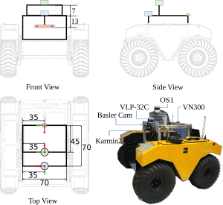
The Image Segmentation Task: RELLIS-3d Dataset
I attempted to apply image segmentation to a real-world problem, through the Rellis-3D dataset
This dataset was compiled based on a robot that drove around Texas A&M
The dataset includes both 2D images and 3D point clouds, but I focused on the 2D data
Jiang, P., Osteen, P., Wigness, M., & Saripalli, S. (2022). RELLIS-3D Dataset: Data, Benchmarks and Analysis.

Slide 4
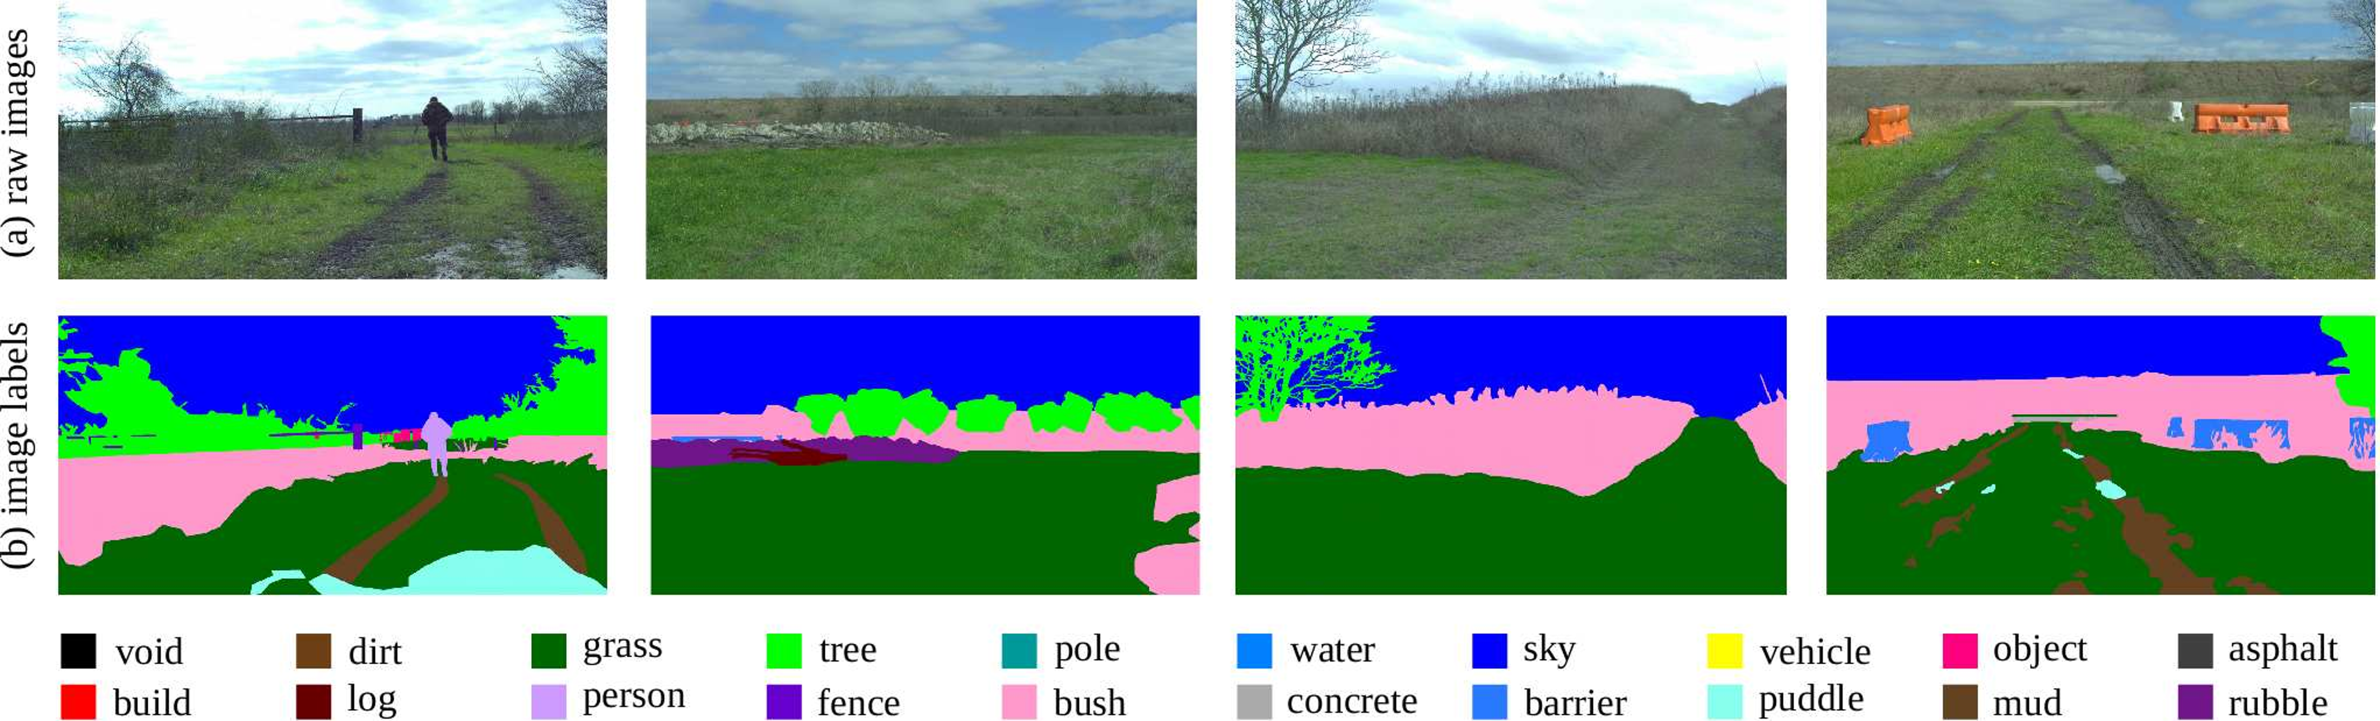
The Image Segmentation Task: RELLIS-3d Dataset
Jiang, P., Osteen, P., Wigness, M., & Saripalli, S. (2022). RELLIS-3D Dataset: Data, Benchmarks and Analysis.

Slide 5
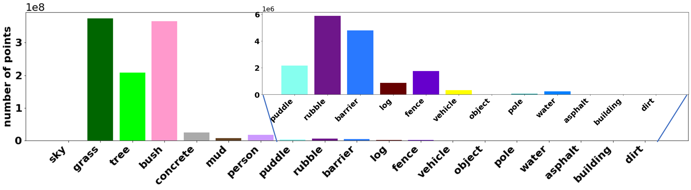
The Image Segmentation Task: RELLIS-3d Dataset
Jiang, P., Osteen, P., Wigness, M., & Saripalli, S. (2022). RELLIS-3D Dataset: Data, Benchmarks and Analysis.

Slide 6
The Model: Fully Convolutional Dense Networks
This paper extends the idea of DenseNets (Huang G., 2015)
DenseNets are convolutional networks constructed of dense blocks made from repeated convolutions
In a DenseNet, each dense block is connected to every other dense block
This paper also extends on the idea of fully-connected networks (Shelhammer E., 2014)
The most famous of these architectures is U-Net, which was the STOA when it was released
Therefore, this paper is a hybrid of these approaches
Jégou, S., Drozdzal, M., Vazquez, D., Romero, A., & Bengio, Y. (2017). The One Hundred Layers Tiramisu: Fully
Convolutional DenseNets for Semantic Segmentation.

Slide 7
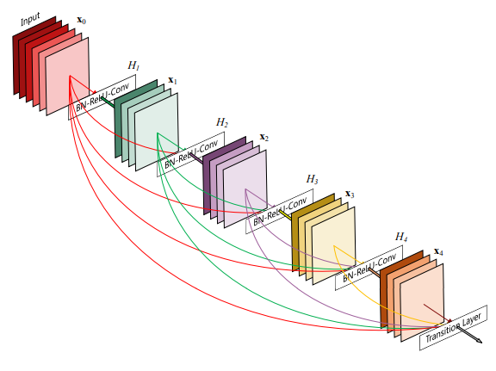
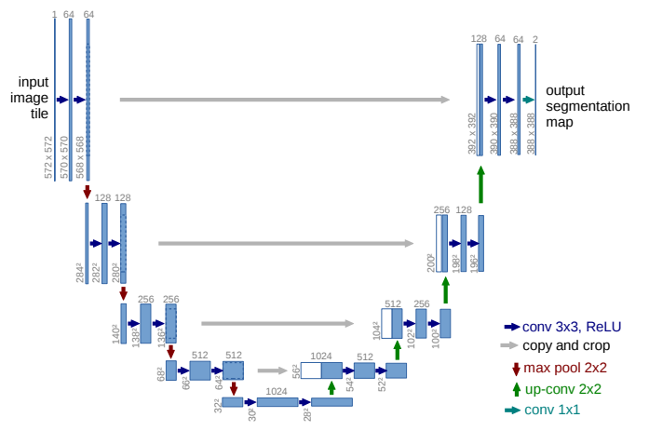
The Model: Fully Convolutional Dense Networks
Huang, G., Liu, Z., van der Maaten, L., & Weinberger, K. Q. (2018).
Densely Connected Convolutional Networks.
Ronneberger, O., Fischer, P., & Brox, T. (2015). U-Net: Convolutional
Networks for Biomedical Image Segmentation. CoRR,
abs/1505.04597. http://arxiv.org/abs/1505.04597

Slide 8
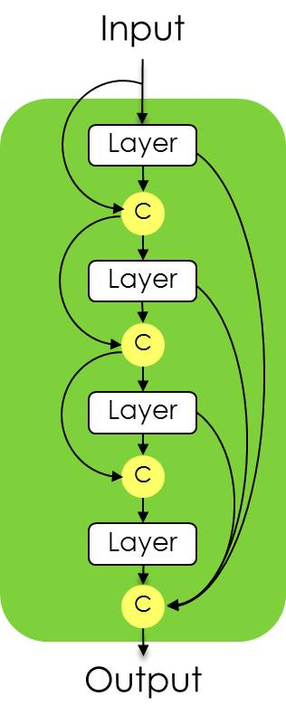
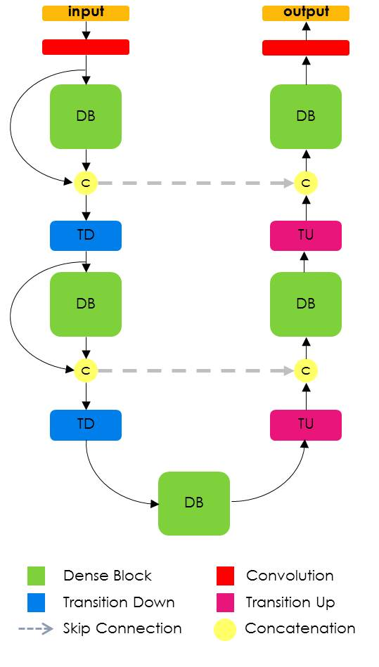
The Model: Fully Convolutional Dense Networks
Jégou, S., Drozdzal, M., Vazquez, D., Romero, A., & Bengio, Y. (2017). The One Hundred Layers Tiramisu: Fully
Convolutional DenseNets for Semantic Segmentation.

Slide 9
Results
My model performed poorly compared to the dataset’s baseline
The paper I implemented is significantly older than the dataset, which explains the discrepancy. My model also only had 5.25 million parameters, which is much smaller than modern networks
The dataset’s baseline earned a Mean IoU of 50.13
Metric | Test Set Score
Top 1 Accuracy | 0.8017
Top 3 Accuracy | 0.9763
Top 5 Accuracy | 0.9899
Mean F1 (Per Pixel) | 0.81
Mean IoU (Per Class) | 20.5753
Jiang, P., Osteen, P., Wigness, M., & Saripalli, S. (2022). RELLIS-3D Dataset: Data, Benchmarks and Analysis.

Slide 10
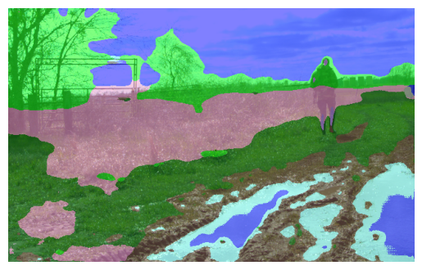
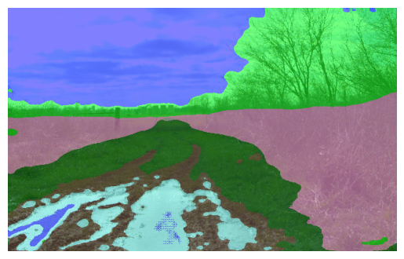
Results

Slide 11
Discussion
Implementing this paper was a fun challenge
My final model included 32 convolutional networks and 30 concatenations
Working with image data was especially frustrating
The full-size images had to be downsampled by 1/3, however, it still repeatedly crashed my GPU
To remedy this, I experimented with distributed training over both GPUs and had to inference only on the CPU
The images generated by the model look okay, but clearly the model cannot handle fine segmentation and struggles to pick out details like people and fences. This is probably because of the unbalanced nature of the classes within the dataset
In future research, I hope to implement a more modern method on this dataset, as I think its interesting to see how the unbalanced data affected the segmentation

